Slide 1



Attendance Reconciliation Automation System
alqama.hasnain@tatasteel.com
FMM-Infrastructure

Slide 2

Background & Problem Statement
The Core Challenge: CLM generates raw punch logs, but native reports fail to reconcile complex billing requirements.
assignment_late
Incorrect Shift Assignment
CLM systems fail to accurately map punches to scheduled shifts.
timer_off
Duty vs. OT Ambiguity
Lack of clear distinction between regular duty hours and overtime.
nights_stay
Cross-Midnight Logic
Failure to handle complex night-shift rotations accurately.
bar_chart
Billing Inefficiency
Absence of skill-wise aggregates required for vendor billing.

Slide 3






PROJECT OBJECTIVES
Seamless Ingestion
Rule-Based Logic
Billing Aggregates
Accepts CLM attendance data : Presentee Report and Punch Records via Excel (.xlsx)
Applies grace periods, late penalties, and OT eligibility based on employee specific profiles.
Generates structured skill-wise and employee-wise billing reports automatically.

Slide 4

Work Hours Calculation Rules

Slide 5
AUTOMATIC SHIFT ASSIGNMENT
Proximity Logic Overview
The system independently determines the correct shift by analyzing actual punch times, discarding CLM-assigned data.
Priority 1: Rotational
A/B/C Match within ±2 hours of start time.
Used for primary rotational shifts to ensure tight alignment with standard scheduling windows.
Priority 2: General
G/W1 evaluated via average-difference score.
Statistical evaluation for non-rotational shifts, calculating the least variance across the entire shift duration.
Includes sophisticated Cross-Midnight Handling for Night Shift (C).

Slide 6
DUTY-IN RECONCILIATION LOGIC
Scenario | Condition | Assigned Duty-In
Early OT | Arrived > 59 min early AND inOtAllowed = true | Rounded UP to next 30-minute mark
Grace | Arrived within 15 min late OR slightly early | Exact Shift Start Time
Penalty | Arrived > 15 min late | Rounded UP to next 30-minute mark
Example: Shift 08:30 | Arrived 08:47 → 17 min late → Duty In: 09:00

Slide 7
DUTY-OUT RECONCILIATION LOGIC
Scenario | Condition | Assigned Duty-Out
Penalty | Left before shift end time | Rounded DOWN to previous 30-minute mark
OT Out | Stayed past shift end AND outOtAllowed = true | Rounded DOWN to previous 30-minute mark
Normal | Left at or after shift end, no OT permissions | Capped at Exact Shift End Time
Example: Shift ends 17:30 | Left 17:15 → Early departure → Duty Out: 17:00

Slide 8
OVERTIME & NET CALCULATION
Total OT = In-OT + Out-OT
Floored to 0.5-hour increments
Total Working Hours = Duty Hours + OT Hours
Floored to 0.5-hour increments
timer
Maximum Duty
Capped at 8 hours (9 with lunch). Ensures regulatory compliance.
exposure_neg_1
Threshold
< 30 mins work results in 0 hours of overtime payment.
analytics
Output
Automated Employee & Skill totals generated for reporting.

Slide 9
Architecture and Technologies Used

Slide 10


SYSTEM ARCHITECTURE
The tool follows a strict Separation of Concerns pattern, distributed across core modules:
cloud_upload
masterFileUpload.js
Dynamic runtime data ingestion for punch logs and presentee reports.
settings
hoursProcessing.js
Pure business logic engine for calculating attendance and OT.
description
renderTable.js
Multi-sheet XLSX export handler for generating billing reports.
arrow_downward
swap_vert
arrow_upward
storage
persistent_data.js
Ground truth database storing employee profiles and master rules.

Slide 11
TECHNOLOGY
Lightweight & Dependency-Free
The application runs entirely in the browser, requiring no server or installation.
code
HTML5/CSS3
Semantic Design for accessible and responsive structure.
javascript
Vanilla JS
Pure & Modular code without external frameworks
table_view
SheetJS
Robust Excel Binary I/O for handling complex data.
cloud_done
GitHub Pages
Reliable hosting with Zero Maintenance overhead.

Slide 12
EFFICIENCY IMPACT

Slide 13
IMPACT ANALYSIS
BEFORE
66hrs
Manual Processing (2k employees)
Error-prone calculations, night-shift calc, and manual aggregation. Per employee ~ 2mins
AFTER
5sec
Automated Processing (for all)
100% accuracy, automated rounding, and one-click export.
trending_flat
> 99% reduction in operational processing time

Slide 14
DYNAMIC SCALABILITY: MASTER FILES
Runtime Database Injection
Users can upload employee details using the Master File Excel Sheet, or bypass, to consider all employees in CLM data.
badge
Sheet 1: Employee Details
Skills, OT Permissions, and metadata
schedule
Sheet 2: Shift Definitions
Configurable In/Out times and rules
Enables seamless use across different vendor groups or departments

Slide 15
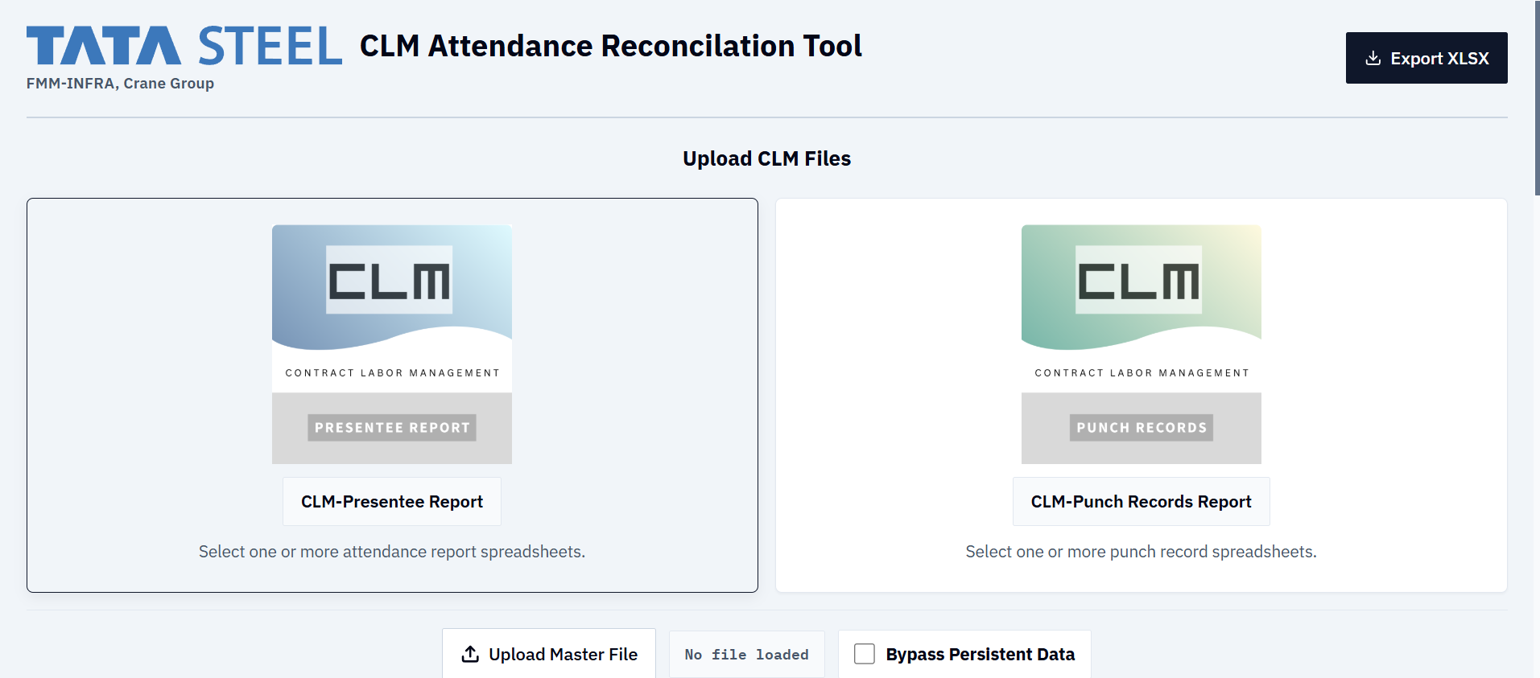
Demo - File Upload

Slide 16
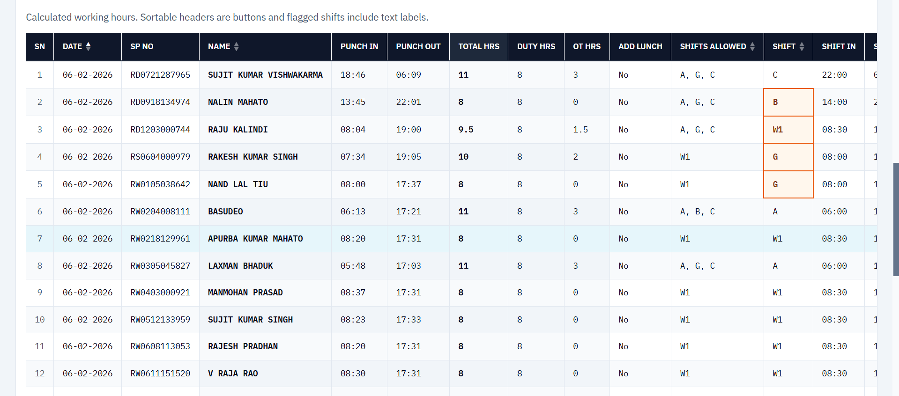
Demo - Calculated Work Hours

Slide 17
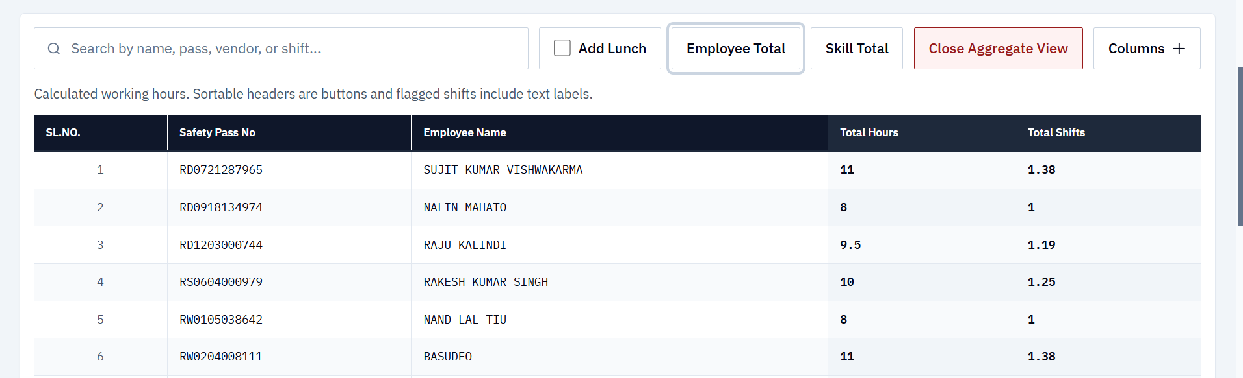
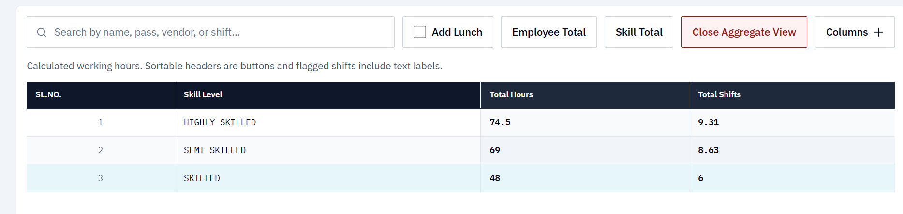
Demo - Aggregation of Skill and Emp Hours

